Slide 1
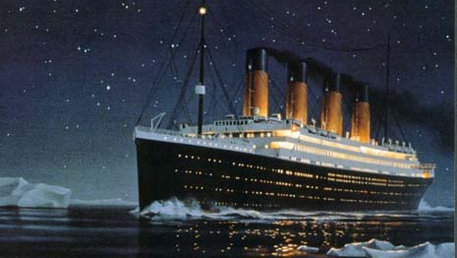
Titanic Project by Jane
This Photo by Unknown Author is licensed under CC BY-ND

Slide 2
This project covers the following topics:
Design
Construction
Life on board
The crew
Icebergs
The sinking
Famous Passengers

Slide 3
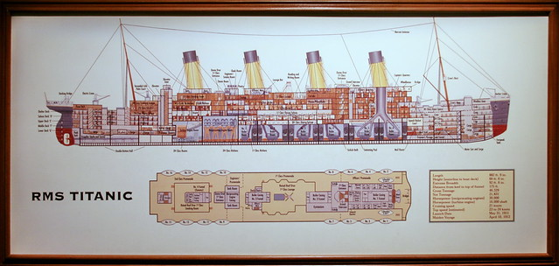
Design
Thomas Andrews was the designer of the titanic.
The design submission for the Titanic was approved in Belfast on July 29 1908 by Bruce Ismay. Thomas Andrew's drawings shows that Titanic incorporated a number of new design features.
The innovative hull was divided up into 16 watertight compartments. The ship was built to stay afloat even if two of the middle compartments, or four of the front compartments flooded.
These watertight compartments offered passengers a sense of security in travelling the high seas. The Titanic was advertised as the world's first "Unsinkable Ship“.
Titanic had too few lifeboats to evacuate all those on board; the 20 lifeboats that she carried could only take 1,178 people, even though she had about 2,223 on board at the time of her sinking.

Slide 4
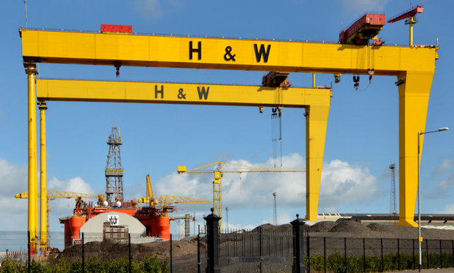
Construction
The titanic was built by Harland and Wolff in Belfast.
The ship took three years to build and cost $7.5 million dollars
The titanic had four funnels but only three of them worked because the fourth one was to make the ship look more powerful.
This huge ship was constructed so that it had 16 watertight compartments to keep the passengers safe, these compartments include steel doors which closed in 25 seconds if any water seeped in.

Slide 5
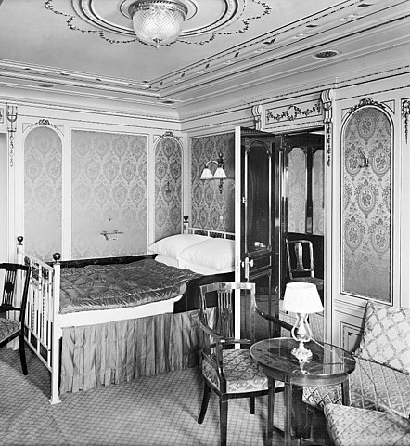
Life onboard
The highest passengers of the Titanic were first class, which was the richest class. Their suites provided bathrooms, private toilets and had up to five different rooms. First class was really expensive. The most expensive first class ticket cost £870 (around £300,000 in todays money). All the rooms were decorated nicely. First class had access to all facilities. They also had personal stuff such as maids, nannies and cooks. First class on the Titanic was way better than other ships At that time.
The second highest passengers of the Titanic were second class. The second class dining room could seat nearly 600 people they are were very elegant. There was a piano in some diners. 2nd class accommodation was found over 7 decks . Second class on the Titanic was comparable to first class passengers on any other ship at the time.
The lowest passengers on the Titanic were third class. Third class was less luxurious .But it was better than other ships at the time. Third class passengers were not allowed to go and explore first and second class areas on the ship . Most third class passengers were immigrants travelling too America from Ireland and Scandinavia . The cheapest third class ticket was £3.
This Photo by Unknown Author is licensed under CC BY-SA

Slide 6
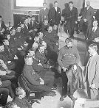
The Crew
There were 908 crew on board the Titanic most of whom came from Southhampton in England.
696 of the crew died and 212 survived.
At 76% – the percentage of crew members who died was higher than even the number of third class passengers
There are many type of crew on the titanic such as deck crew, engineering department, stewards and gallery staff, restaurant staff, musicians and post staff, and lets not forget the Captain of the Titanic, Captain Smith.
The maiden voyage of the Titanic was to be 62 year old Captain Smith’s last voyage before he retired. His monthly wage was £105. Very little is known about his actions on the Titanic after the collision – he was last seen on the bridge of the sinking ship. Captain Smith went down with his ship and his body was never recovered.
The chief officer was Henry Wilde. His monthly wage was £25. He was off duty when the ship hit the iceberg. He took control of the even numbered lifeboats and was last seen trying to free the collapsible lifeboats. Wilde’s body has never been recovered.

Slide 7
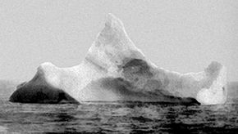
Icebergs
An iceberg is a large piece of freshwater ice that has broken off a glacier or an ice shelf and is floating freely in open water.
Icebergs are dangerous because they are huge and they float low in the water which can cause danger to the ships. They flip over sometimes. When they flip over the energy is so great it can cause tsunamis and on occasion can trigger earthquakes.
The Titanic hit an iceberg, they are unsure of the exact size of the iceberg but according to newspapers from the time they approximated it to be 50 to 100 feet high and 200 to 400 feet long. The Titanic was 400 miles (640km)away from it’s destination when it struck the ice berg.

Slide 8
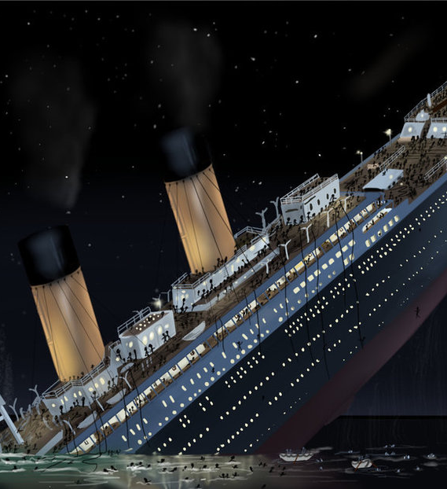
The sinking
At 2:20 a.m. on April 15, 1912, the British ocean liner Titanic sank into the North Atlantic Ocean about 400 miles south of Newfoundland, Canada. The massive ship, which carried 2,200 passengers and crew, had struck an iceberg.
As the ice bumped along its starboard side, it punched holes in the ships steel plates, flooding six compartments. In a little over 2 hours, the titanic filed with water and shattered as if it was hit by a hammer.
Because of a shortage of lifeboats more than 1,500 people went down in the sinking ship or froze to death in the icy North Atlantic waters. Most of the 700 or so survivors were women and children.
One hour and 20 minutes after Titanic went down, the Cunard liner Carpathia arrived. The survivors in the lifeboats were brought aboard, and a handful of others were pulled out of the water. It was later discovered that the Leyland liner Californian had been less than 20 miles away at the time of the accident but had failed to hear the Titanic‘s distress signals because its radio operator was off duty.
Announcement of details of the tragedy led to outrage on both sides of the Atlantic. In the disaster’s aftermath, the first International Convention for Safety of Life at Sea was held in 1913. Rules were adopted requiring that every ship have lifeboat space for each person on board, and that lifeboat drills be held.
On September 1, 1985, a joint U.S.-French expedition located the wreck of the Titanic lying on the ocean floor at a depth of about 13,000 feet. The ship was explored by manned and unmanned submersibles, which shed new light on the details of its sinking.

Slide 9
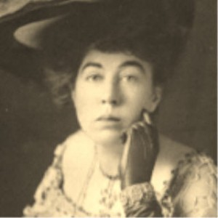
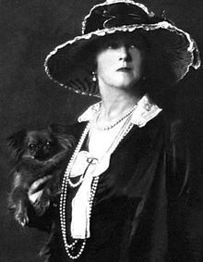
Famous passengers
Margaret brown was born in 1867 and was a philanthropist and a activist who gained great deal of fame from the sinking of the Titanic after boarding lifeboats six she returned to the sinking ship to look for other survivors no one knows if there were any survivors left after but it was still worth it. And her nickname is the Unsinkable Molly Brown. Margaret Brown died in 1932.
Lucy Christiana, Lady Duff-Gordon was a leading British fashion designer in the late 19th and early 20th centuries who worked under the professional name Lucile. She her husband and secretary all travelled as first class passengers on the Titanic. They all disembarked in lifeboat number 1 and survived the sinking.
John Jacob Astor IV, was the richest man aboard the ship, when his body was recovered he had $2440 on him.

Slide 10
Thank you for watching, I hoped you enjoyed the presentation.

