Slide 1
THE ROUTE
The Titanic route was to be a return trip from Britain to America.
The outward route was to be Southampton, England – Cherbourg, France – Queenstown(Cobh), Ireland – New York, USA.
But was cut short by a tragic accident !!
The return route was going to be New York – Plymouth, England – Cherbourg – Southampton.
For four days, Titanic made good progress across the Atlantic, powered by three coal-burning engines. But it was no easy job to keep her moving. Each day, the ship’s 175 ‘fire men’ shovelled 600 tonnes of coal into the furnaces — that’s the weight of 100 elephants!

Slide 2
LIFE ON BOARD
The Titanic was no ordinary ship, she was the most impressive and luxurious ship of her time!
She was the biggest, too, measuring 28 metres wide, 53 metres tall and 269 metres long — that’s about the length of three football fields!
Life on board Titanic depended on who you were and how much money you had…
The Titanic was devided into first class 2nd class and 3rd class.
First class passengers were some of the richest and most important people of the time.
Many of the second class passengers were tourists, made up of professions such as teachers and clergy.
The passengers in third class were mainly immigrants heading for a new life in America. They came from a variety of locations across Europe.

Slide 3
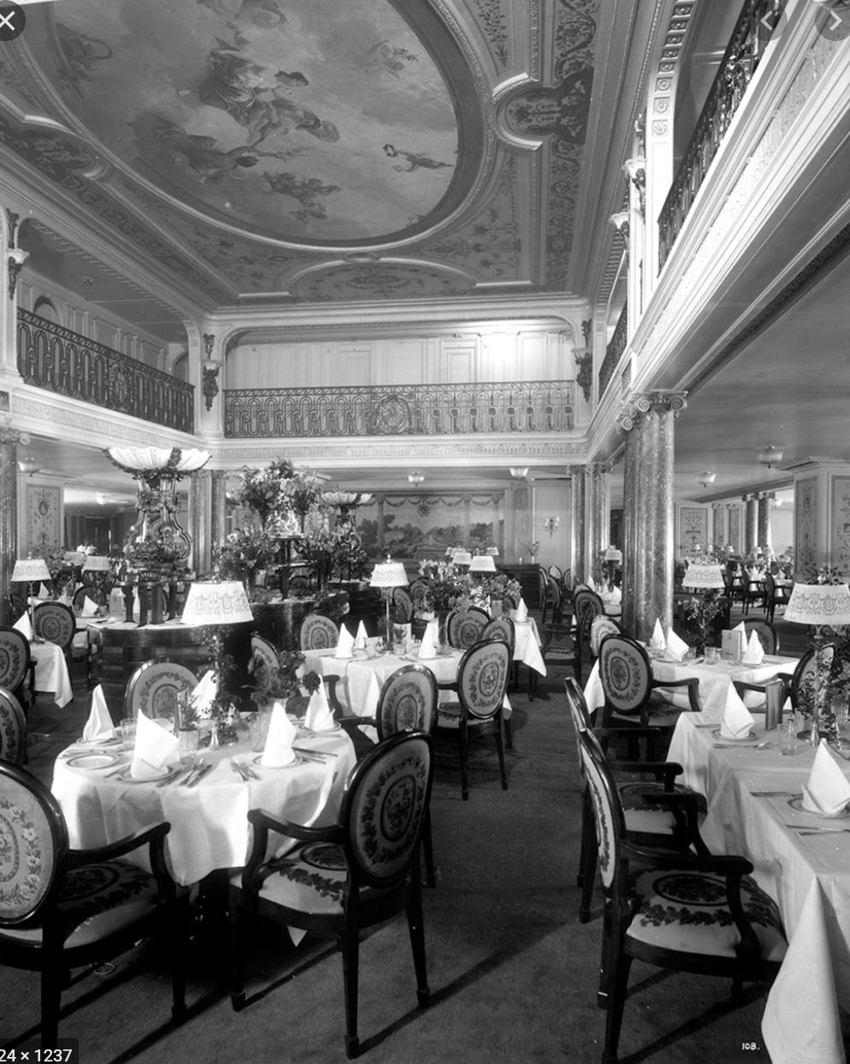
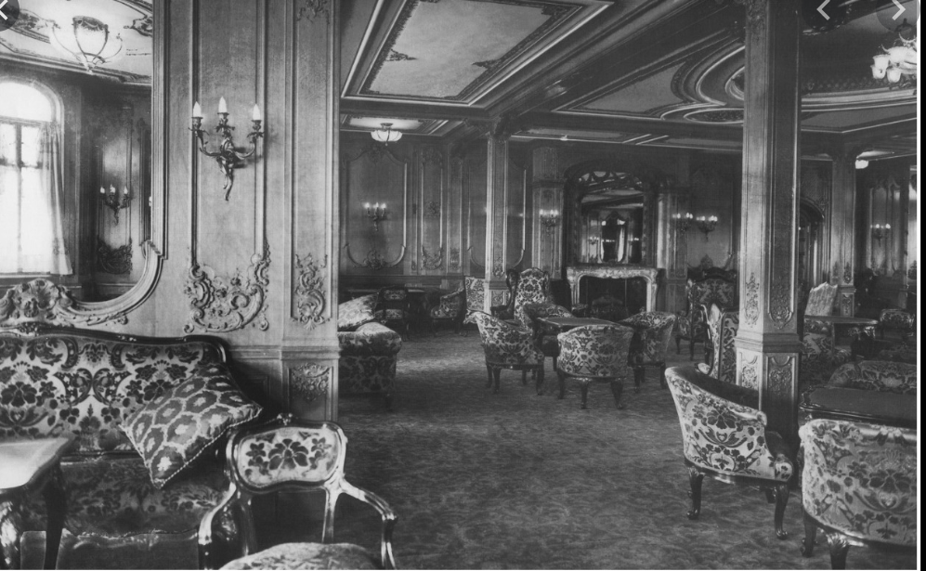
FIRST CLASS
First class on board Titanic was the ultimate in luxury. It included veranda cafes, a smoking room, restaurant, a dining saloon and a reading and writing room. The facilities on Titanic far surpassed those of rival ships of that time.
The first class passengers really dined in style. The dining room was the largest ever seen on a ship and a live orchestra played background music. The furniture and panelling was carved in fine detail in oak, mahogany and sycamore.
The more energetic passengers could play deck games, such as shuffleboard, and use the gym, squash courts and swimming pool on board. Games such as chess and backgammon could be played on the deck.
Titanic had 39 private suites located at the top of the ship. They had 2 large bedrooms, 2 walk-in wardrobes and a bathroom. There was also a spacious living with room for guests. Suites cost up to £870 which is the equivalent of £79,000 today!

